Slide 1


SMART WATER SYSTEM AUTOMATIC IRRIGATION
BY
C SANJAY

Slide 2

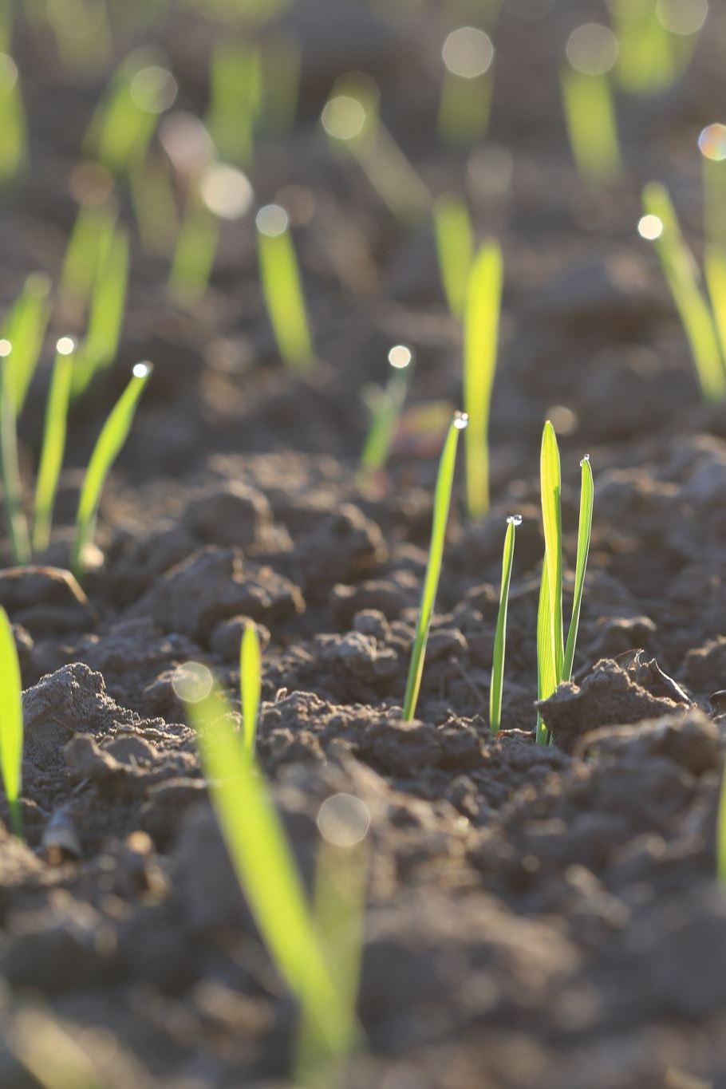
PROBLEM DEFENITION
The problem of automatic irrigation aims to develop a system that efficiently manages the watering of plants in agricultural settings.
This system must address several challenges, including optimizing water usage, monitoring soil moisture levels, and ensuring timely irrigation based on environmental conditions.
The goal is to create a cost-effective and sustainable solution that reduces water wastage while promoting healthy plant growth.

Slide 3

PROJECT DEFINIT ION
This project will integrate cutting-edge sensor technology to continuously monitor soil moisture levels, weather conditions, and other environmental factors.
This project also emphasizes sustainability by reducing water wastage and promoting responsible irrigation practices. Users will have the convenience of remotely monitoring.
Ultimately, our goal is to provide a cost-effective, eco-friendly, and user-centric solution that enhances agricultural productivity and garden maintenance while conserving valuable resources.

Slide 4
DESIGN THINKING
1.PROJECT OBJECTIVES:
Our project aims to optimize water usage by delivering irrigation only when necessary, ensuring soil moisture levels are maintained within desired thresholds.
Complying with relevant regulations and standards, promoting scalability, and optimizing energy efficiency round out our comprehensive project objectives.

Slide 5

2.IoT SENSOR DESIGN​
By integrating sensors like soil moisture, temperature, humidity, and rain detectors, Arduino empowers these systems to collect real-time environmental data critical for optimal irrigation decisions.
Moreover, Arduino's compatibility with various communication modules and its active open-source community ensure that it remains a go-to choice, offering accessibility, expandability, and ease of customization in the development of efficient and user-friendly automatic irrigation systems.

Slide 6

3.REAL-TIME TRANSIT INFORMATION PLATFORM
The data collected from sensors is then transmitted to a centralized database for real-time analysis.
Users gain access to these insights through user-friendly interfaces and manual adjustments.
This platform offers precision, scalability, and adaptability, ultimately contributing to healthier plants, improved crop yields, and responsible resource management.

Slide 7

4.INTEGRATION APPROACH
Sensor Data Collection: These sensors continuously monitor the relevant parameters, such as soil moisture levels, temperature, humidity, and rainfall. When a sensor takes a reading, it generates data.
Data Processing and Formatting: The sensor data is processed using microcontrollers like Arduino. The data is formatted into a structured format, such as JSON or XML, making it suitable for transmission.
Communication Protocols: IoT sensors use various communication protocols to transmit data to the data-sharing platform.
Wi-Fi: Sensors connect to a local Wi-Fi network and send data over the internet to a cloud-based platform.
Cellular Networks: Sensors with cellular modules can transmit data directly to the platform through mobile networks.

Slide 8

THANK YOU

